Slide 1




Multi-agent modelization for flexibility evaluation in residential dwellings
Autor (intern): Lasha Khubashvili
Supervisors: WURTZ Frederic
Stéphane PLOIX
FlexRICAN

Slide 2
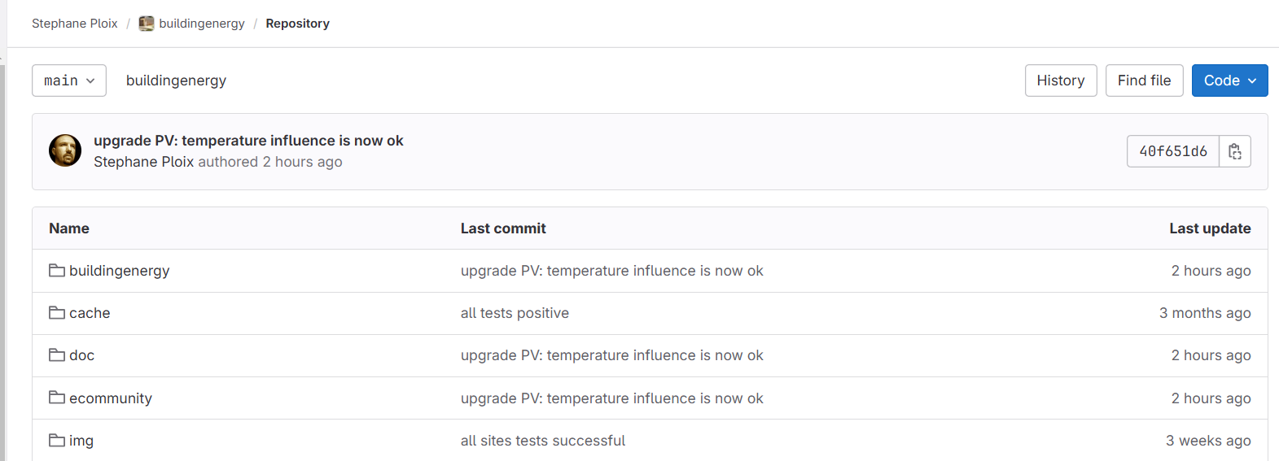
Building energy
Building Energy provides a simulation of residential buildings designed to optimize energy consumption in residential buildings by leveraging smart data management and flexible consumption strategies.
This project covers several directions of energy consumption simulations for different buildings. However, we used Notebook 9 for our project as part of the residential buildings simulation.
Ref: Buildingenergy (Stephane Ploix)

Slide 3
Project distribution and development: Notebook 9
Notebook 9 is a strategy for dividing the population into Energy communities. This provides a plan for uniting dwellings according to their locations, view of energy consumption, friendly agreements, etc. that offers easy access for the dispatcher to predict or control community actions and apply different strategies
For the simulation, Python coding language is used to develop different strategies, methods, and data analysis. Jupiter Notebook is used for visualization, to see what feedback we can have, and to observe the simulation.
2 main packages are used for simulation, which include modules and methods. These are:
buildingenergy
Solar
openweather
Ecommunity
basic
nosignal
reactive
adaptive
reactadapt
dynamic
irise
Irise
House
Appliance
Notebook 9
Ecomunity
buildingenergy
ecommunity
openweather
solar
basic
nosignal
reactive
adaptive
reactadapt
dynamic
irise
FLEXIBILITY
IRISE
House
Appliance
CANCELLABLE
INTERRUPTIBLE
DELAYABLE
ANTICIPATORY
STARTABLE
Different scenarios for energy strategy
Date calibration
Datetime processing
Acceleration
Data analyze
Data processing
Data extraction
Flexibility can be positive and negative, according to the needs of the grid operator.

Slide 4
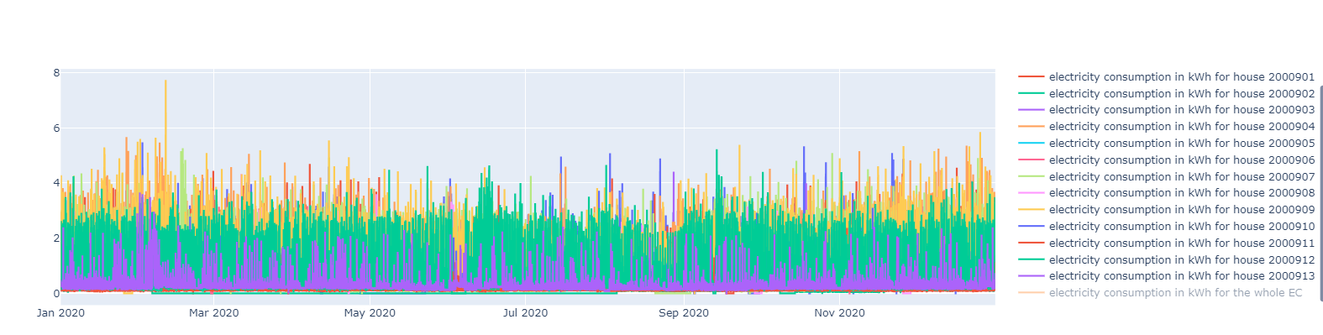
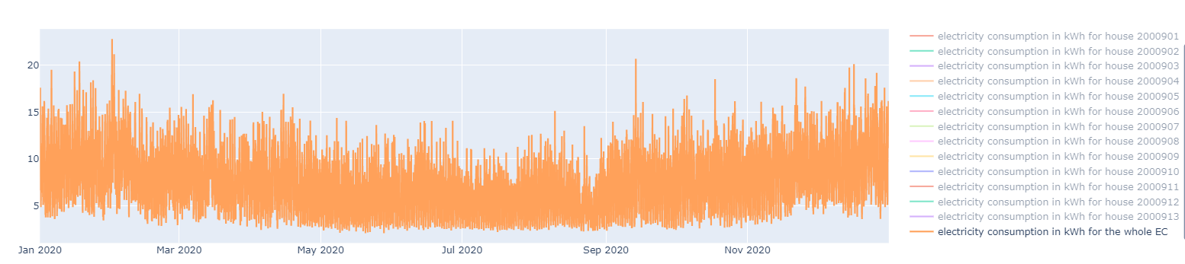
Filtering dwellings by territory (Grenoble) and plotting their total consumption by house ID
Total electricity consumption for all houses

Slide 5
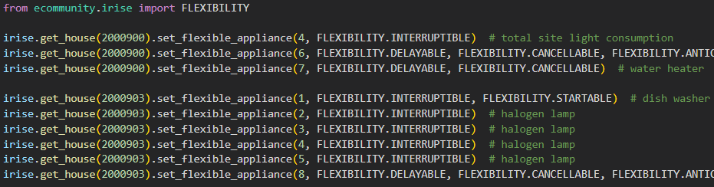
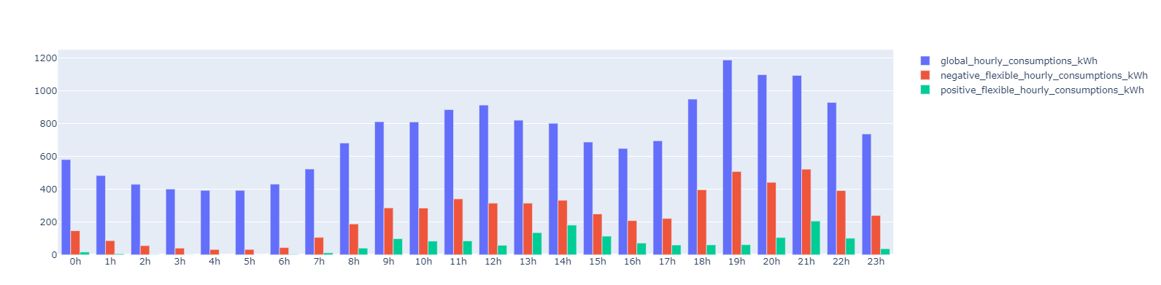
Depth of flexibility
Flexibility conditions are given for each energy appliance which helps us divide them into categories
We can give categories for each appliance by making a loop that will categorize similar appliances and automatically apply these flexibility categories for all houses.
Total consumption of all grouped houses consumed in 24 hours during one year. Positive and negative flexibilities in 24 hours during 1 year

Slide 6
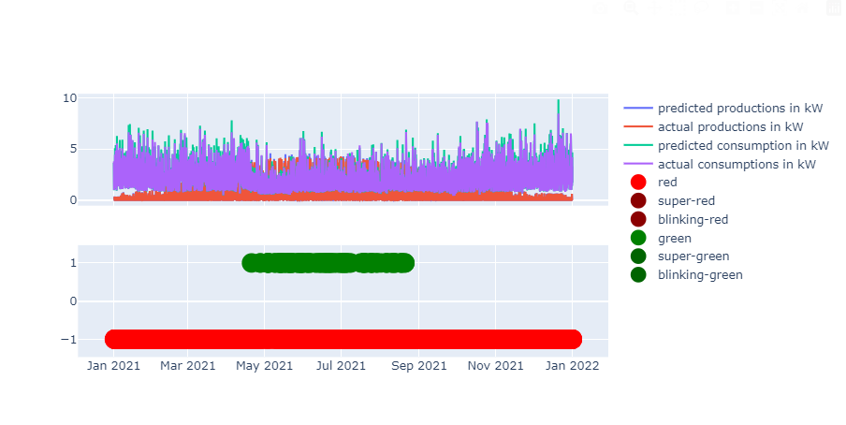
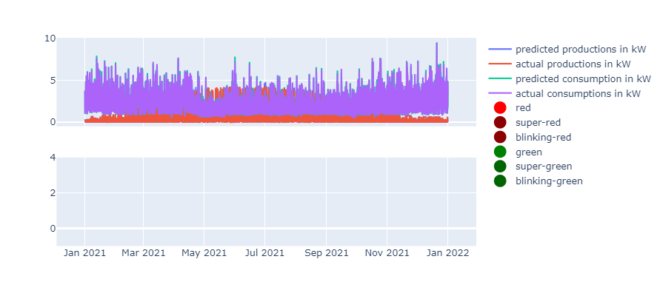
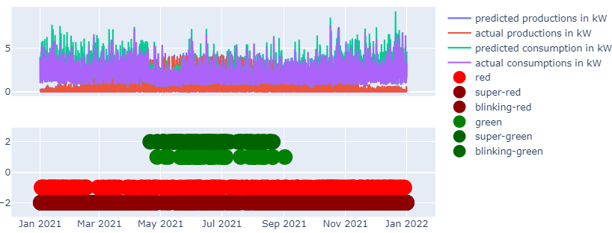
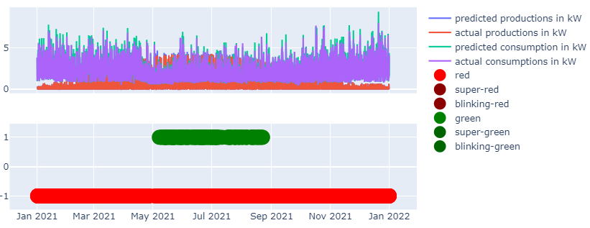
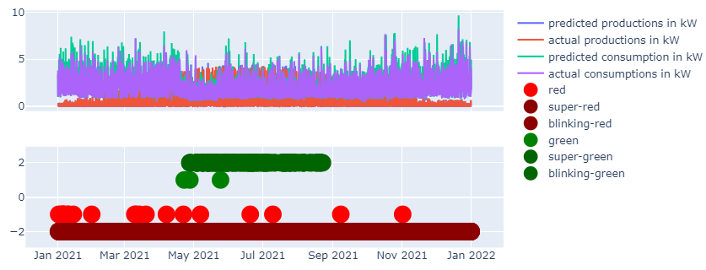
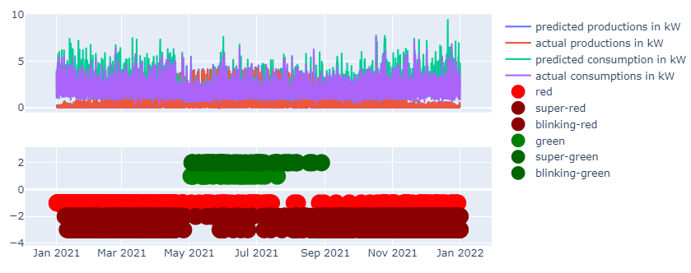
Basic scenarios simulation
Color Strategy
6 levels of alert can be sent, depending on the strategy:
BLINKING_GREEN: the highest level of demand for an increase in consumption
SUPER GREEN: average level of demand for an increase in consumption
GREEN: lowest level of demand for an increase in consumption
WHITE, no alert
RED: lowest level of demand for reduction of consumption
SUPER RED: average level of demand for reduction of consumption
BLINKING RED: the highest level of demand for reduction of consumption
Strategies
No-signal strategy
Basic strategy
Reactive strategy: (if basic is not enough)
Adaptive strategy (Decisions for color alerts depend on past reactions)
Adaptive and reactive strategy (Similar to the adaptive strategy, but uses blinking alerts if changes are insufficient)
Dynamic strategy (Alerts depend on predefined ratios of different colors)
Performance Indicators
Efficiency
NEEG (KWH/day)
Self-consumption (%)
Dependency (1-Self-sufficie, %)
Autonomy
Cost (€)
Annoyance Level
Renunciation (%)
Number of alerts per day
Actual share for a member
Contribution of EC members
Effort (%)
1)
2)
3)
4)
5)
6)

Slide 7
Future development
Simple indicators which will be general need to be adapted for this simulation
We can also try to apply our complex indicators to the simulation
Compare the effect of difficult and simple indicators on consumption
Need to take out PV consumption and add Flexibility conditions
Need to think of different strategies for simulation
We can start with very easy strategies for example if demand is high and needs to shift send a red signal to avoid using flexible devices.
We can apply the same but only for specific hours….
we can only ask customers which devices they have at home and then apply our method. (if we can know the power of each device it could be easier to predict).

